Slide 1

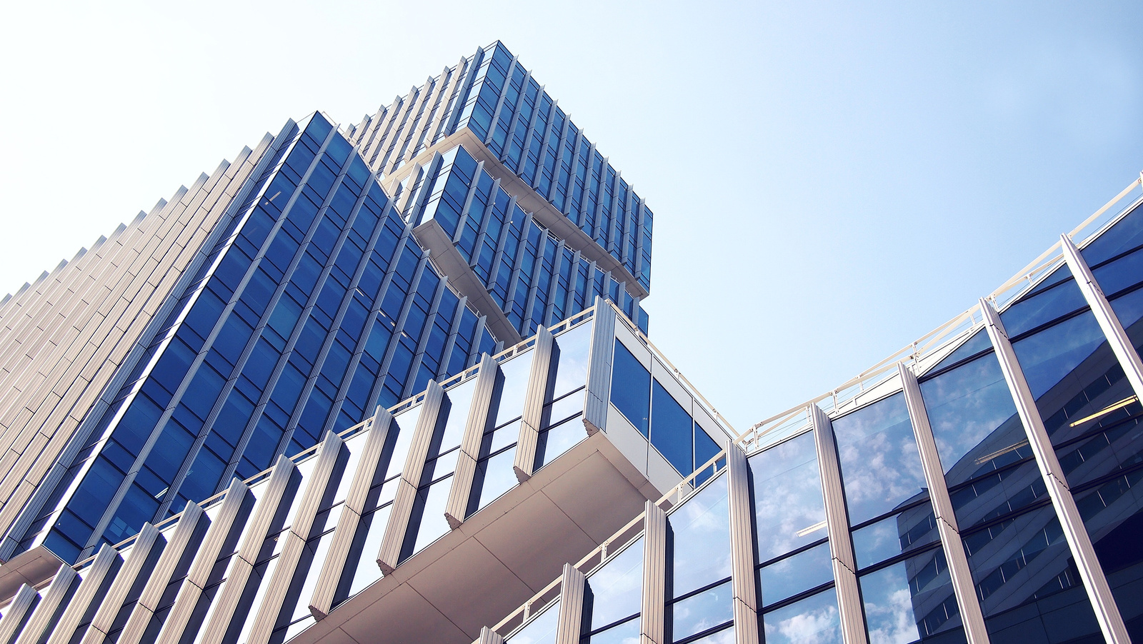
ACOUSTICS & AV CONSULTANTS
Professional Acoustic Consultancy Services
Architectural & Industrial Acoustics | Environmental Noise

Slide 2


ABOUT US
We are a professional acoustic consultancy firm providing scientific, independent, and performance based acoustic solutions for the built environment. Our expertise lies in analyzing, designing, and optimizing acoustic comfort while ensuring compliance with national and international standards.
With a strong technical foundation and practical project experience, we work closely with architects, project management consultants, developers, and engineers to integrate acoustic performance seamlessly into architectural and MEP designs.
Our consultancy approach is focused on clarity, compliance, and constructability—ensuring that recommended solutions are both technically effective and practically achievable on site.
| AWARE Acoustics |
Page 02

Slide 3

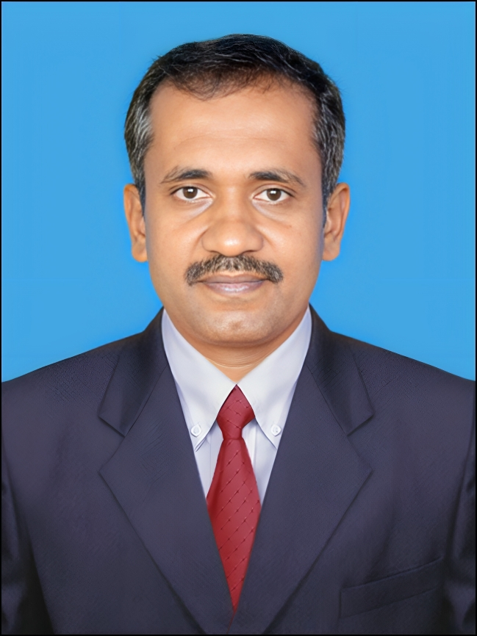
OUR TEAM
With over 18 years of experience in technical acoustical consultancy, Acoustics delivers high-performance solutions across architectural, environmental, and mechanical acoustics. The principal consultant is specialized in Acoustics from IIT Kharagpur and holds a graduate degree from BMS College of Engineering, with strong expertise in EASE, ODEON, and advanced 3D acoustic modelling tools. The consultancy has executed acoustical simulations and designs for major Indian airports and multiple underground metro stations, contributing to acoustically efficient and regulation-compliant infrastructure.
With over 12 years at MMG Acoustical Consultants, Bengaluru, a pioneer in the field, extensive experience was gained in noise and vibration studies, environmental and mechanical acoustics, detailed design, technical reports, drawings, BOQs, and multidisciplinary coordination.
The portfolio includes prestigious clients such as Adani, Microsoft, VMware, Google, Cisco, Adobe, and MBRDI. Well-versed in LEED, ASTM, ISO, BSI, and ASHRAE standards, Acoustics focuses on sustainable, performance-driven design, delivering comprehensive and customized acoustical solutions across India.
PADMANABHA
| AWARE Acoustics |
Page 03

Slide 4
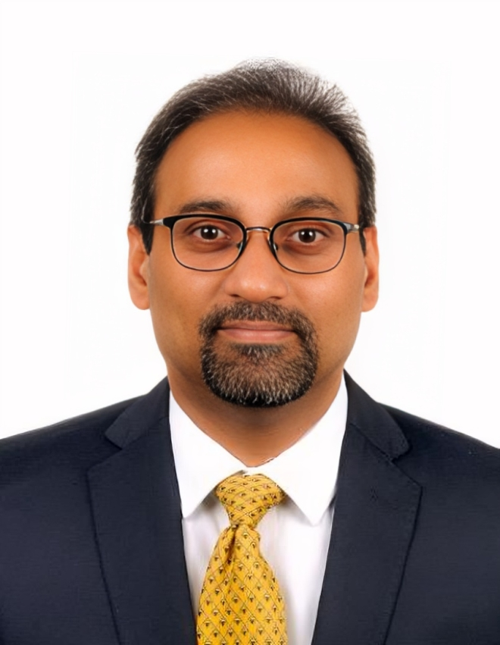
OUR TEAM
A seasoned professional with strong expertise in Business and Product Development, backed by a proven track record in niche acoustical product development and consultancy. Highly skilled in technical and design consultancy, acoustics engineering, and customer relationship management. A graduate of Bangalore University, with a deep understanding of translating technical solutions into practical, value-driven outcomes.
With over 25 years of overall professional experience, including 12+ years dedicated to the acoustics domain, he has been actively involved in end-to-end product development, acoustical design consultancy, and testing & measurement. His experience spans work with leading organizations specializes in Building Acoustics, Environmental Noise & Product Acoustics in alignment with International Standards.
He has successfully managed key accounts and strategic engagements with several prominent national and global organizations, including Google, Dell, Microsoft, Bank of America, IBM, Atlassian, Intel, GSK, Amazon, Bank of New York, Standard Chartered Bank, Novo Nordisk, IIM Visakhapatnam, and IIT Hyderabad, among others.
.
SRIKANTH T
| AWARE Acoustics |
Page 04

Slide 5
Standards Followed
Design Standards
BS 8233:2014 – Sound insulation & noise control in buildings
IS 2526 – Acoustical design of auditoriums & conference halls
ASHRAE Handbook (2015) – HVAC noise & vibration control
DIN 18041 – Acoustic quality in small & medium-sized rooms
EN 12354 (Parts 1–6) – Prediction of building acoustic performance
Measurement & Testing Standards
ISO 16283-1:2014 – Airborne sound insulation (field measurement)
ISO 3382 – Reverberation time measurement
ISO 717-1 / JIS A 1419-1 – Rating of airborne sound insulation
ISO 354 – Sound absorption measurement
ISO 12999-1:2014 – Measurement uncertainty in building acoustics
IS 9736 – Acoustics terminology for buildings
Green Building & Wellness Standards
LEED v4 / v5 – Acoustic performance (EQ Credit)
WELL Building Standard – Sound Mapping & Acoustic Comfort
| AWARE Acoustics |
Page 05

Slide 6

VISION
To be a premier provider of acoustic solutions, creating better-sounding environments by effectively addressing sound and noise control challenges across diverse applications.
MISSION
To deliver engineering-driven acoustic solutions that enhance human comfort and speech clarity through innovative design, while effectively controlling unwanted noise across diverse built environments.
| AWARE Acoustics |
Page 06

Slide 7
Green Norms & Sustainability
We integrate environmentally responsible materials and design strategies into our insulation and acoustic solutions to minimize environmental impact while maintaining high standards of sound engineering and performance. Our approach emphasizes the use of recycled and renewable resources, low-VOC materials, and sustainable systems that support healthier indoor environments and long-term sustainability.
Key Focus Areas:
Use of recycled and renewable insulation and acoustic materials
Preference for low-VOC and environmentally safe products
Sustainable and eco-friendly design strategies in acoustic treatments
Selection of materials compliant with green certifications (ISO 14001, LEED, and equivalent standards)
Identification and engagement of geographically proximate suppliers meeting green compliance requirements to reduce carbon footprint
| AWARE Acoustics |
Page 08

Slide 8
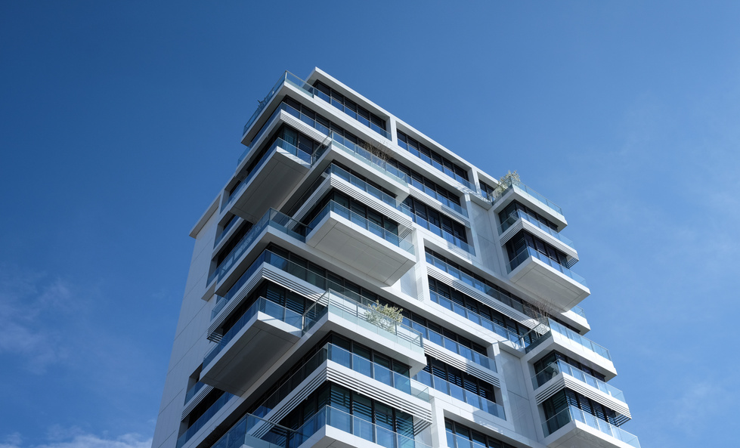
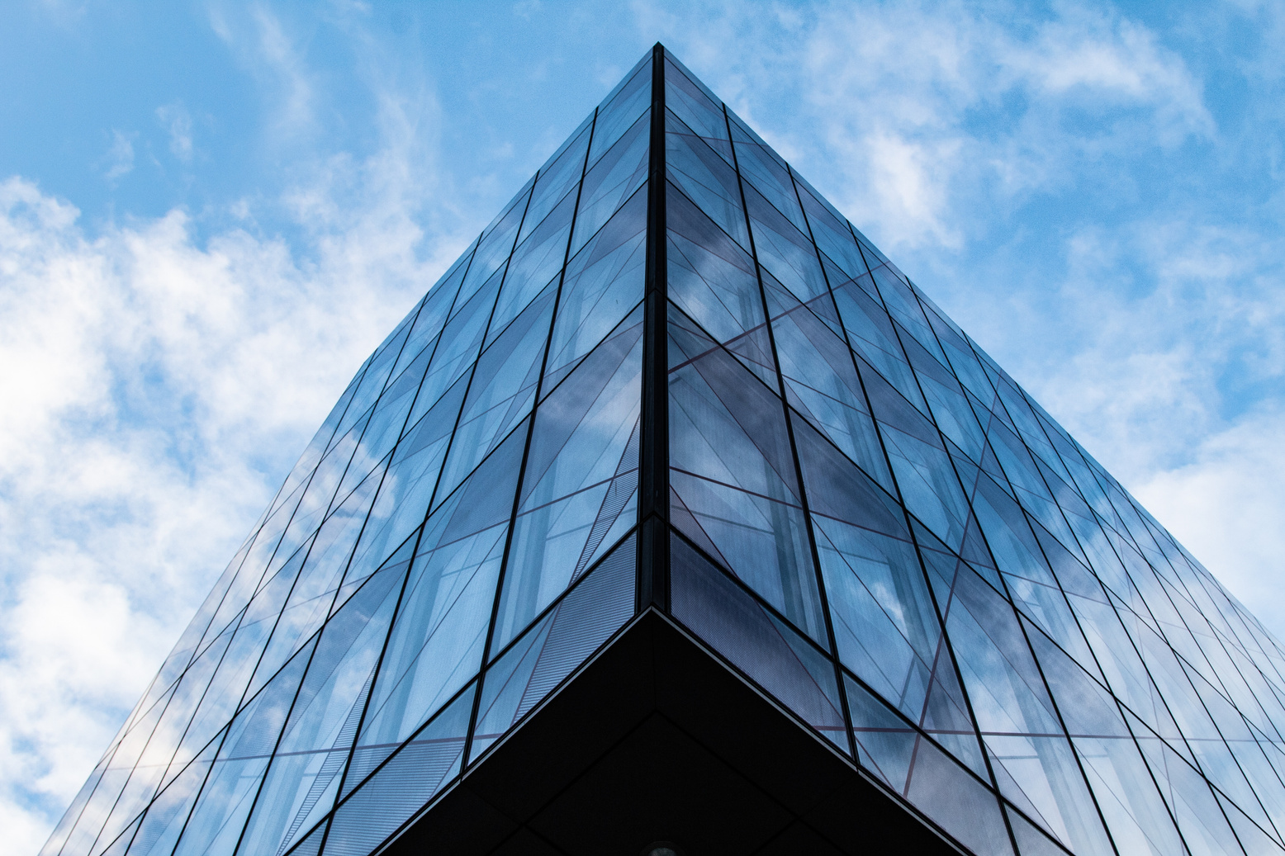
OUR SERVICE
We are an independent acoustic consultancy delivering high-impact sound, noise, and vibration solutions using cutting-edge measurement systems and simulation tools. We optimize acoustic performance across offices, residences, studios, and industrial environments..
We enhance site performance by focusing on all parameters of Acoustics such as :
• Sound Insulation
• Noise Control
• Speech Clarity
We deliver tailored acoustic solutions for corporate offices, studios, call centers, and diverse environments—ensuring every space performs exactly as intended.
| AWARE Acoustics |
Page 09

Slide 9
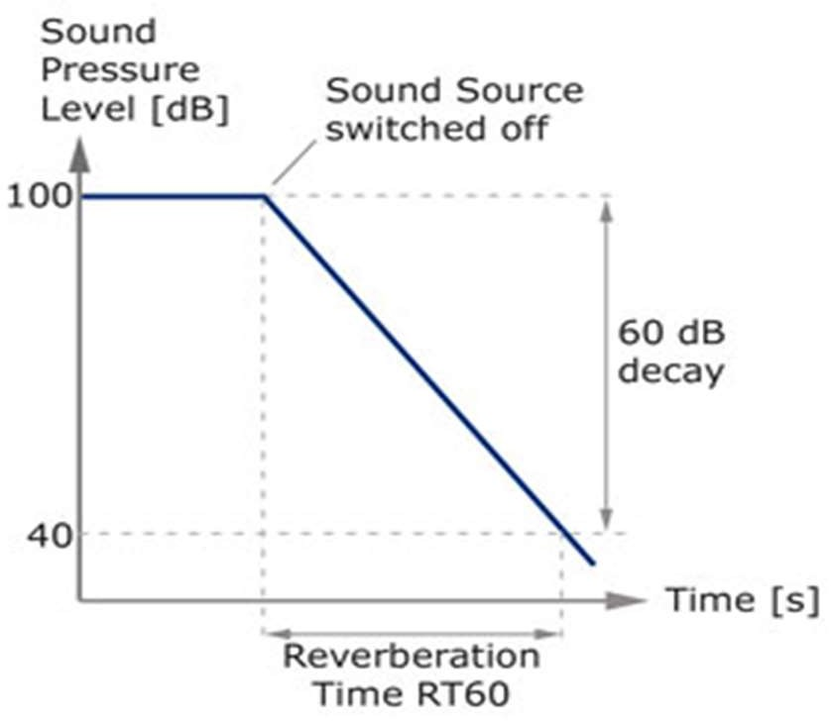
Reverberation Time (RT60)
Ta = 0.16 V/A
Where
Ta = reverberation time(s)
V = room volume (m3)
A = the total sound absorption of the room (m2 Sabine)
Reverberation Time (RT) is the duration required for sound energy in an enclosed space to decay by a specified amount after the sound source is abruptly stopped. It is typically measured as a 60 dB reduction, referred to as RT60.
RT60 is a widely accepted acoustic parameter used to characterize the acoustic quality of spaces such as concert halls, auditoriums, and performance venues, indicating how long sound persists before diminishing to 60 dB below its initial level.
| AWARE Acoustics |
Page 10

Slide 10
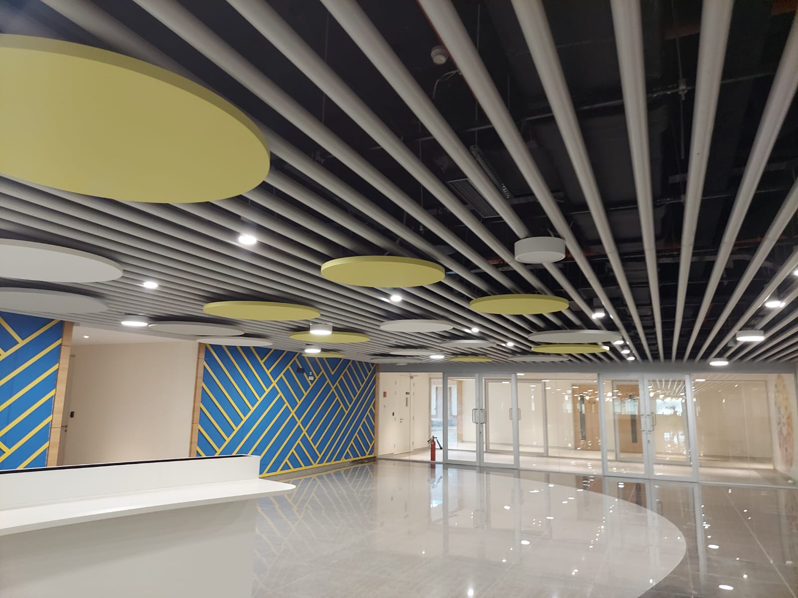
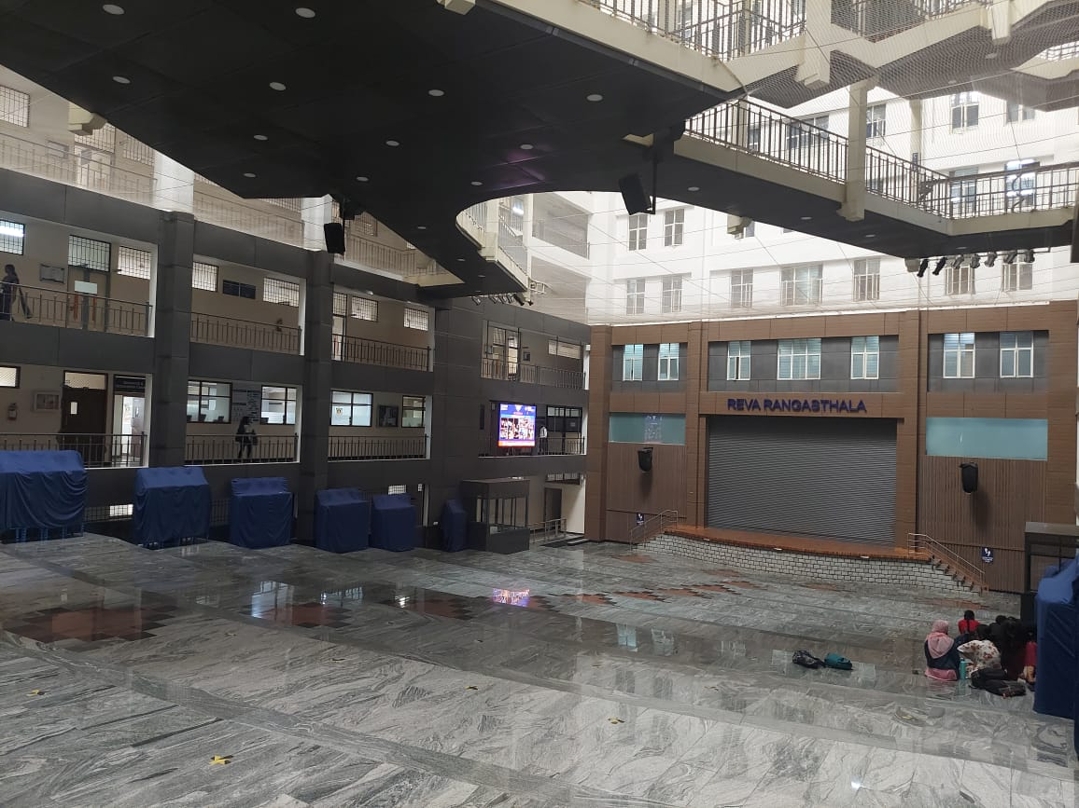
Reverberation Control
Reverberation control is achieved through the strategic placement of sound-absorbing materials on walls, ceilings, and floor surfaces.
Material selection is based on the NRC (Noise Reduction Coefficient) to meet the desired acoustic performance criteria.
| AWARE Acoustics |
Page 11

Slide 11
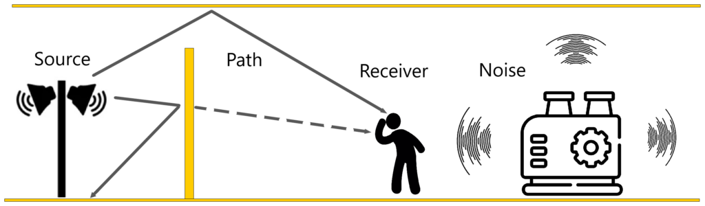
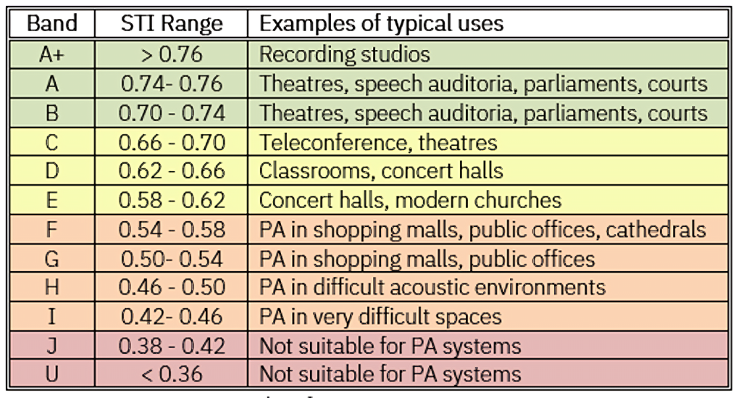
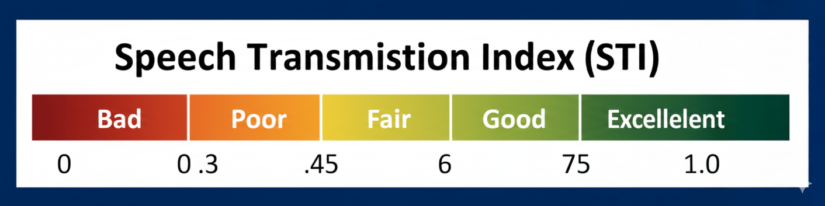
Speech Transmission Index (STI)
The Speech Transmission Index (STI) is a standardized metric that quantifies speech intelligibility in a space.
Rated on a scale from 0 to 1, it evaluates the effects of noise, reverberation, sound masking, filtering, and signal degradation on speech clarity, and is widely used to assess and optimize acoustic performance in communication-critical environments.
| AWARE Acoustics |
Page 12

Slide 12
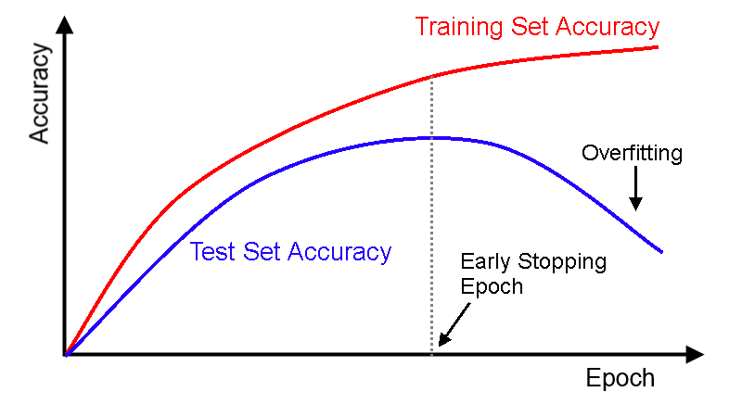
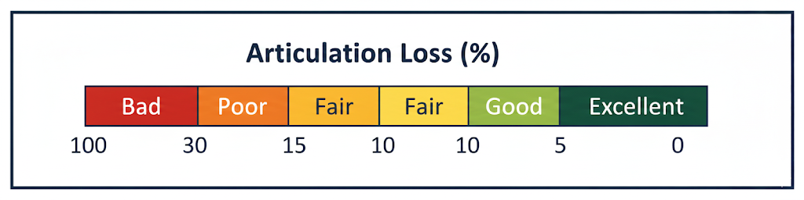
Articulation Loss
Articulation Loss of Consonants (ALCONS) represents the percentage of consonants that are not correctly perceived by a listener, indicating speech clarity and intelligibility within a space.
An ALCONS value of 0% denotes excellent speech intelligibility with no consonant loss. Values around 10% indicate reduced clarity and progressively poorer intelligibility, while 15% is generally considered the upper limit of acceptable articulation loss.
Background Noise: Ambient noise can mask consonant sounds, reducing speech clarity and making words harder to distinguish.
Reverberation: Excessive reverberation or echoes smear speech over time, particularly affecting the intelligibility of consonants.
Speaker Quality: Speakers with weak vocal projection or poor articulation typically result in higher ALCONS values.
Listener Hearing: Individuals with hearing loss or reduced speech perception ability are more likely to experience increased articulation loss.
| AWARE Acoustics |
Page 13

Slide 13
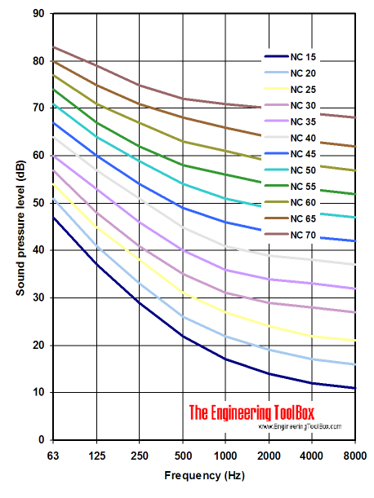
Noise Criteria – Background Noise
Noise Criteria (NC) is determined by measuring the background noise within a building using a 1/1-octave band spectrum. The measured sound levels are plotted against a family of standard NC curves, covering frequencies from 63 Hz to 8000 Hz, to evaluate overall noise acceptability..
| AWARE Acoustics |
Page 14

Slide 14
Noise Reduction Coefficient (NRC)
The Noise Reduction Coefficient (NRC) is a standardized, single-number rating used to evaluate the sound absorption performance of acoustic materials. It represents the average sound absorption coefficient measured at mid-frequency octave bands.
NRC values range from 0.0 to 1.0, with higher values indicating greater sound absorption and reduced sound reflection within an enclosed space.
NRC 0.0: No effective sound absorption; sound energy is fully reflected.
NRC 0.5: Moderate absorption, with approximately 50% of incident sound energy absorbed.
NRC 1.0: High absorption, with most incident sound energy absorbed and minimal reflection.
Measurement Standards: NRC values are typically determined in accordance with ASTM C423 / ISO 354, based on laboratory measurements conducted in a reverberation chamber.
| AWARE Acoustics |
Page 15

Slide 15
Simulation
Acoustic simulation uses advanced computer software to model and predict the behavior of sound within a given environment. By digitally simulating sound propagation, noise levels, and acoustic performance, we are able to analyze and optimize sound quality in a space before physical construction or prototyping.
The simulations account for key acoustic phenomena such as sound reflections, absorption, and diffraction, enabling informed design decisions and performance-driven solutions.
Acoustics Analysis Results
  Key Benefits of Acoustic Simulation
  Optimize overall sound quality and speech intelligibility
  Identify potential noise and acoustic performance issues at early design stages
  Support efficient and cost-effective design of spaces and systems.
RT
Sound Pressure Level Distribution 0- Seating, Identify Hot spots
Reflections
Clarity Metrics
Frequency Response
Design Recommendations - Acoustics Treatment Suggestions
Geometry Adjustments
System Integration
Validations – Measurements
User Needs
Tools & Inputs
Software Used: EASE
Material Properties: Absorption and reflection coefficients for all surfaces
Sound Source Modeling: Stage layouts, loudspeaker positions, and source characteristics
| AWARE Acoustics |
Page 16

Slide 16
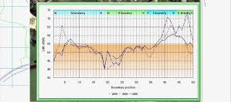
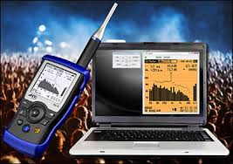
Noise Survey & Assessment
We analyze noise pollution sources and evaluate their impact on surrounding environments to ensure compliance with local regulations. Leveraging strong acoustical expertise, we provide actionable insights and tailored solutions for effective noise mitigation.
Through data-driven analysis, we identify noise pollution sources and assess their environmental impact in compliance with local regulations. Our in-depth acoustical expertise enables us to deliver precise, actionable recommendations for effective noise mitigation
| AWARE Acoustics |
Page 17

Slide 17
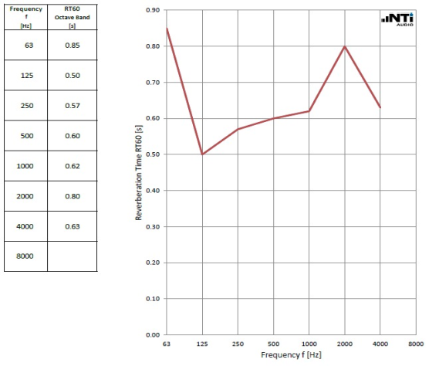
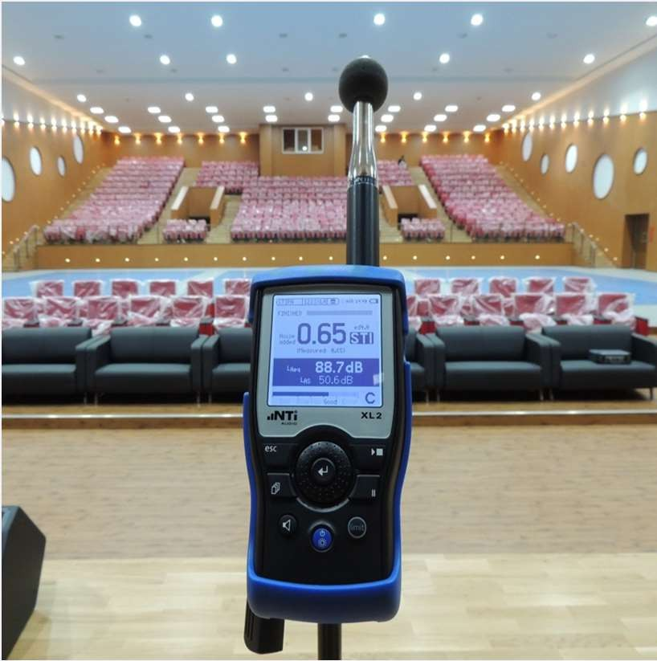
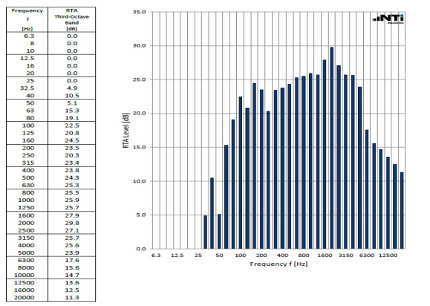
Instrumentation
Reverberation Time (RT60)
Speech Transmission Index (STI)
Speech Privacy Between Adjacent Spaces
Ambient Noise Level Assessment
Speech Intelligibility Evaluation
Acoustic Simulation & Modelling
Noise Criteria (NC) Curve Analysis
| AWARE Acoustics |
Page 18

Slide 18
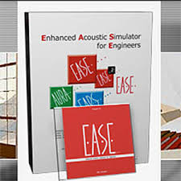
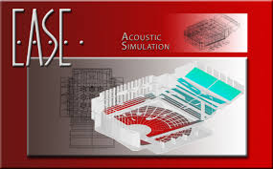
Software’s
EASE (Enhanced Acoustic Simulator for Engineers) is a powerful software tool used for the simulation and acoustic design of architectural spaces to identify and address potential acoustical challenges. It enables detailed audio signal modeling and analysis of key acoustic parameters such as Reverberation Time (RT), Speech Transmission Index (STI), Articulation Loss, Sound Pressure Level (SPL), and overall speech intelligibility.
The software also allows engineers to predict how sound behaves within a specific space and to evaluate the impact of various acoustic treatments. By simulating different design scenarios, EASE helps optimize acoustic performance and improve sound quality before implementation.
| AWARE Acoustics |
Page 19

Slide 19
Acoustic Performance Parameters for LEED
HVAC Background Noise Levels
Partition Sound Insulation (STC Rating)
Reverberation Time (RT60)
Ambient Noise Criteria (NC Levels)
Acoustic Performance Parameters – WELL :
Adequate Wall Construction (2 Points)
Proper Door Specifications (1 Point)
Reverberation Time Compliance (RT60) (1 Point)
Sound-Absorbing Ceiling Systems (1 Point)
Sound-Absorbing Vertical Surfaces (1 Point)
Sound Masking Systems Implementation (2 Points)
Impact Noise–Reducing Flooring Systems (1 Point)
| AWARE Acoustics |
Page 20

Slide 20
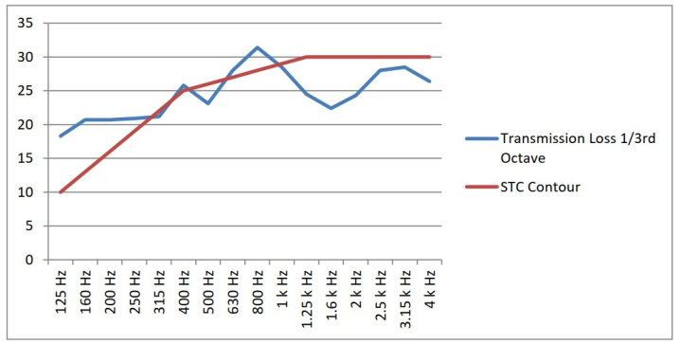
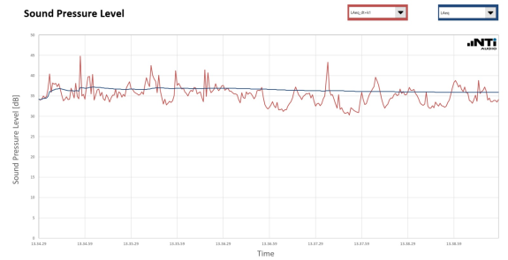
Acoustic Design & Consultancy Services
Design & Documentation
Acoustic design guidelines & documentation
DBR & detailed acoustic drawings
Floor STC marking & sound insulation layouts
MEP noise & vibration control recommendations
Value engineering suggestions
Review & Tender Support:
Proposed & updated interior layout reviews
Tender drawings & BOQ specifications review
Material & sample submissions evaluation
Review & Tender Support:
On-site mock-up reviews
Acoustic testing & measurement reports
Final DBR & compliance reporting
| AWARE Acoustics |
Page 21

Slide 21
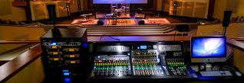

Audio Visual
and Digital
Transformation

Slide 22
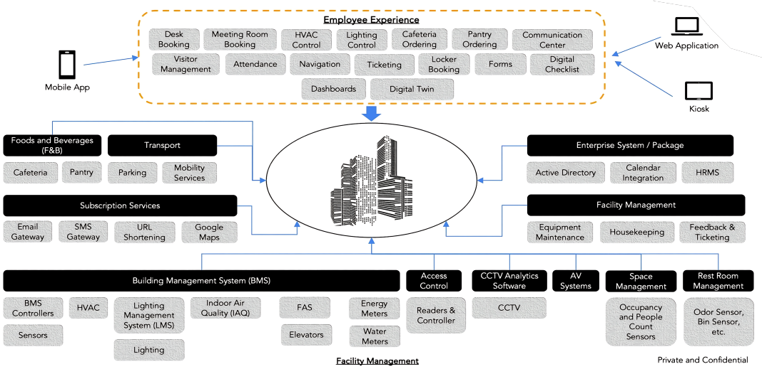
Digital Workplace Framework

Slide 23
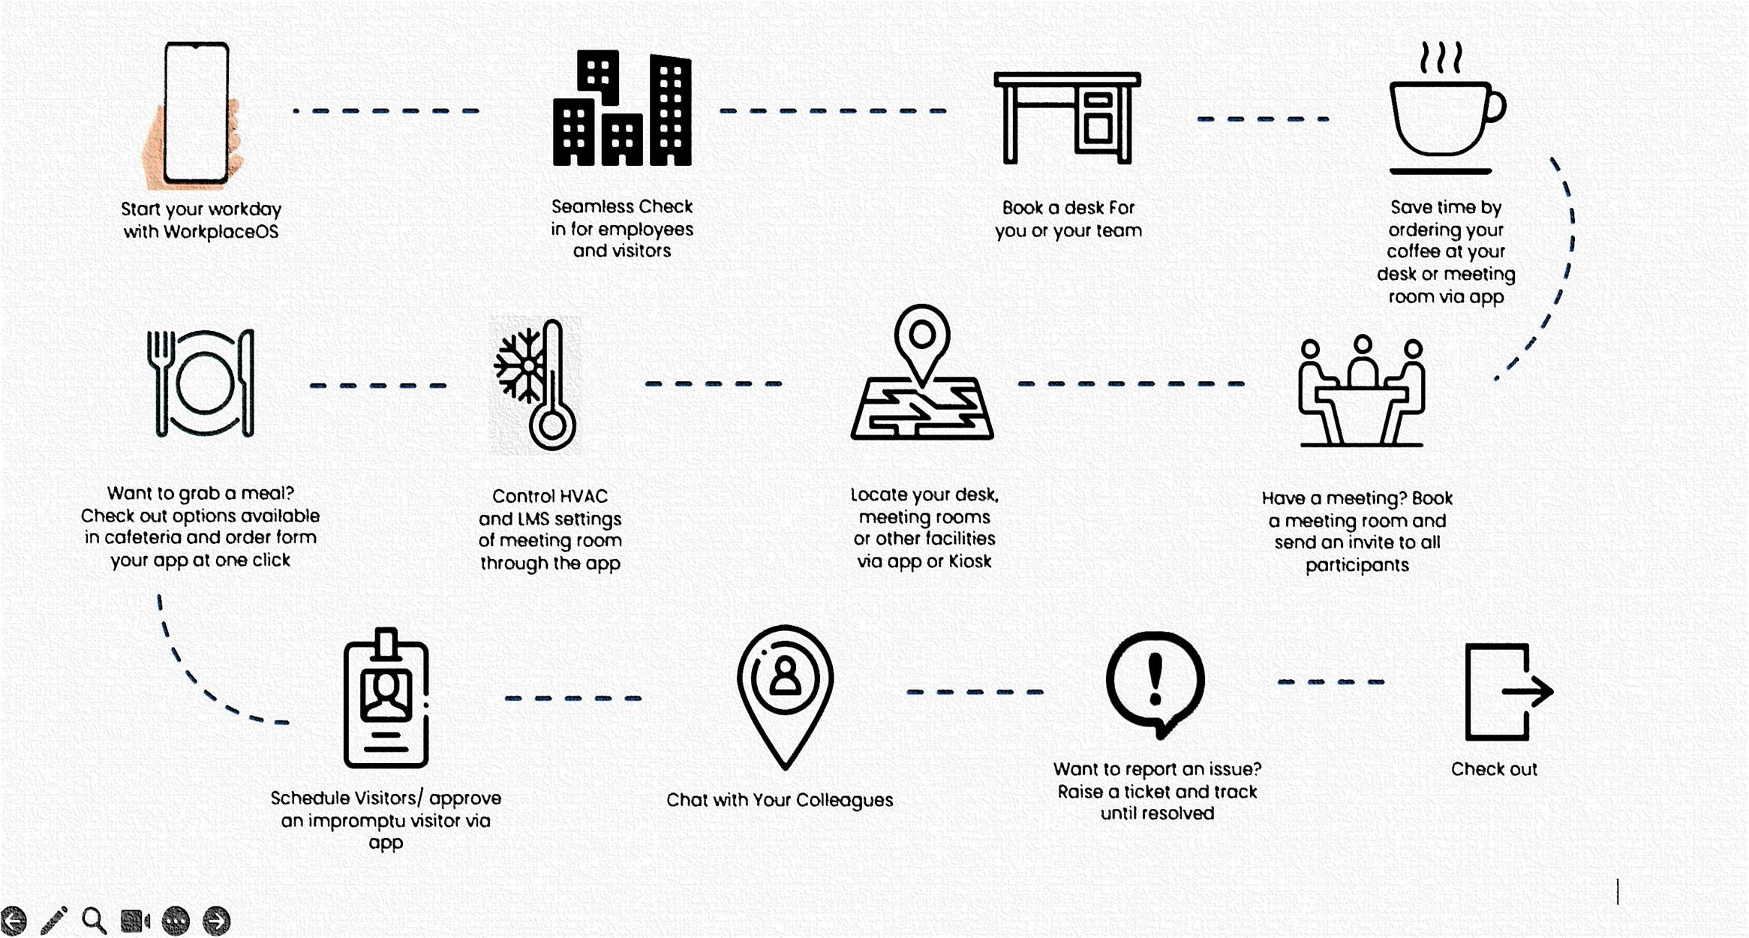
A Day in Life of An Employee Workplace

Slide 24
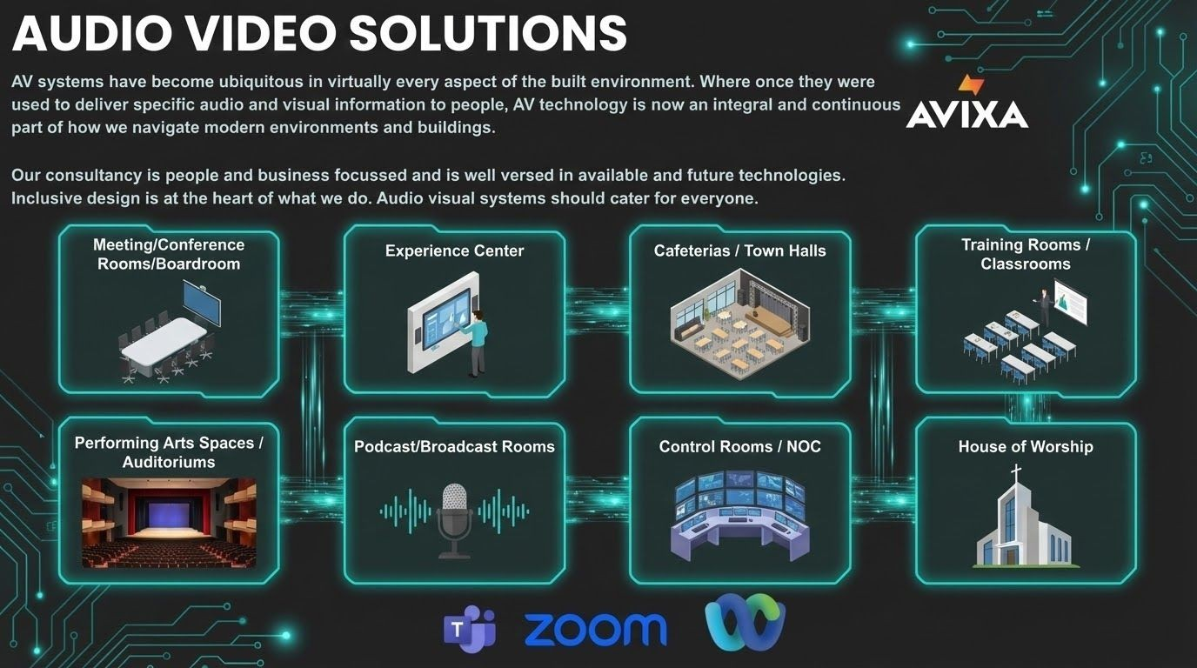


Slide 25


Slide 26
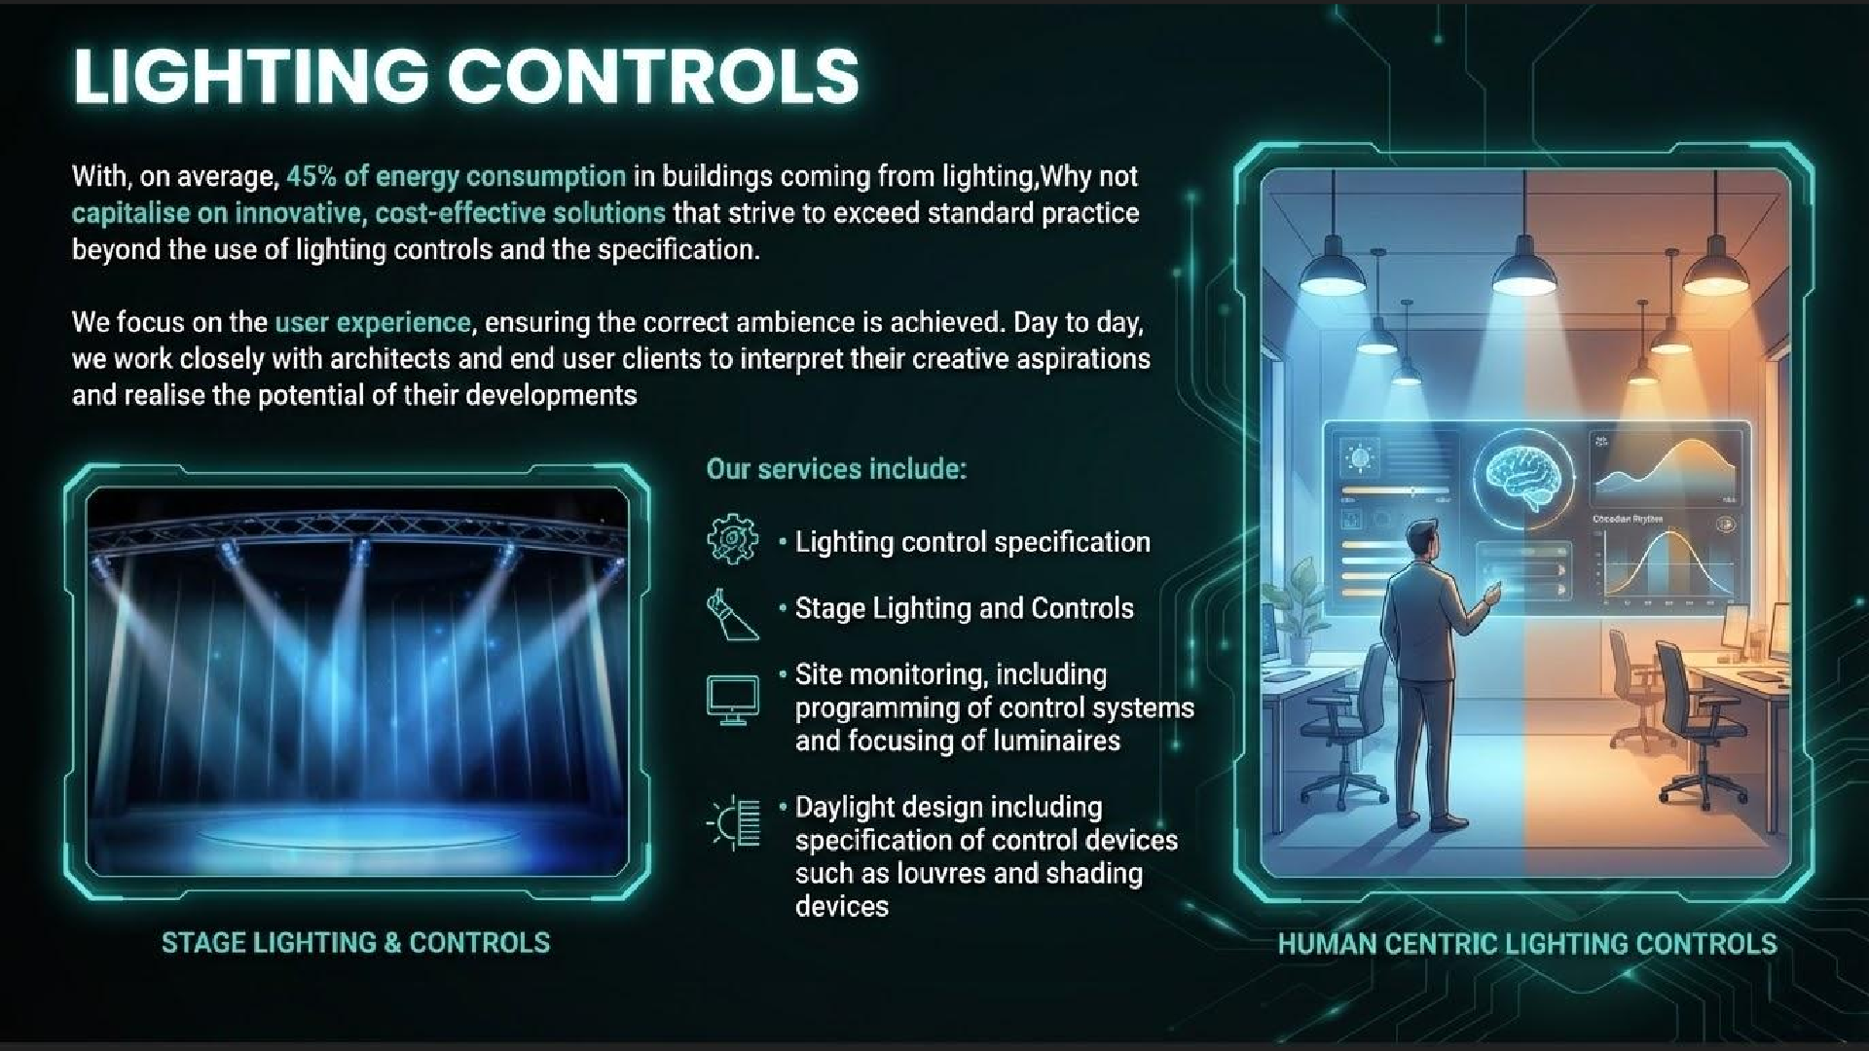

Slide 27
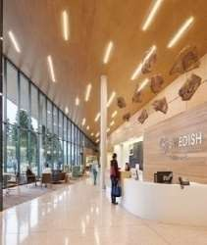
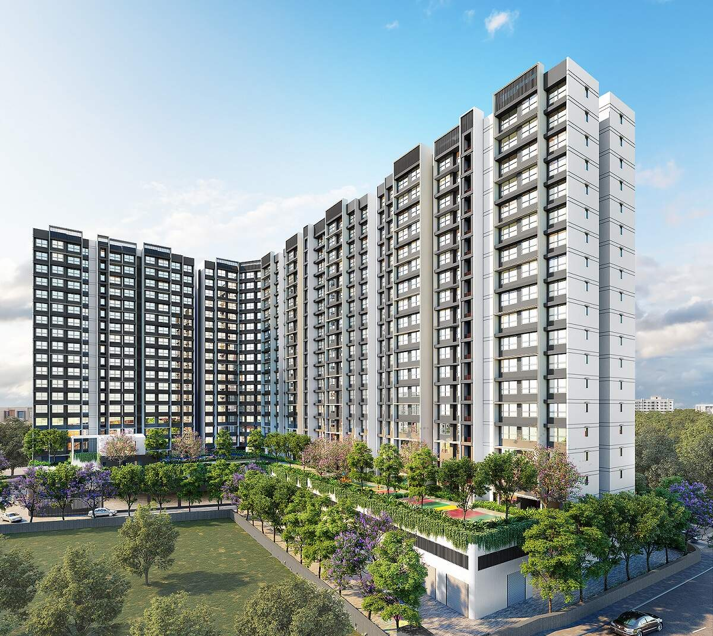
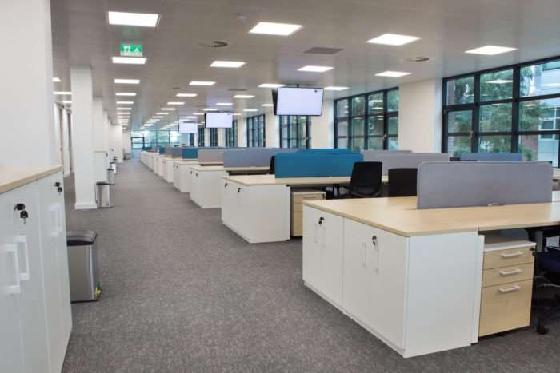
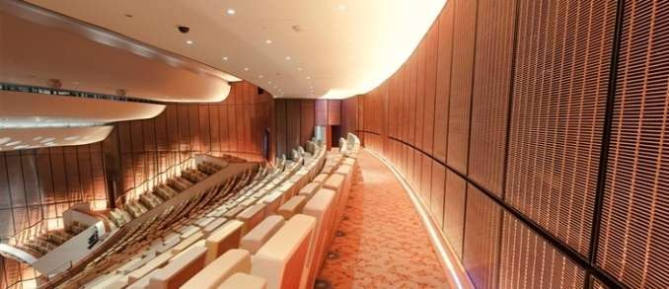
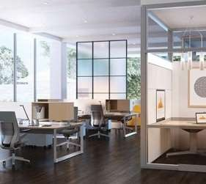
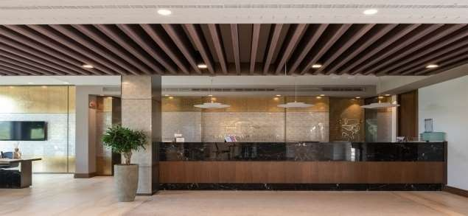

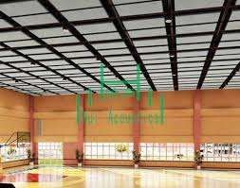
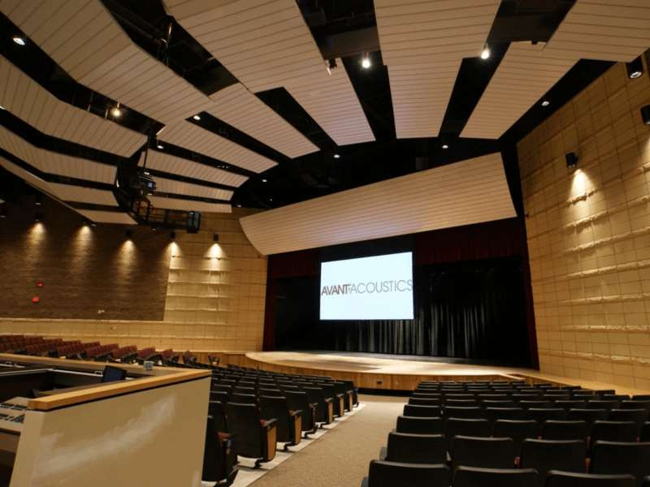
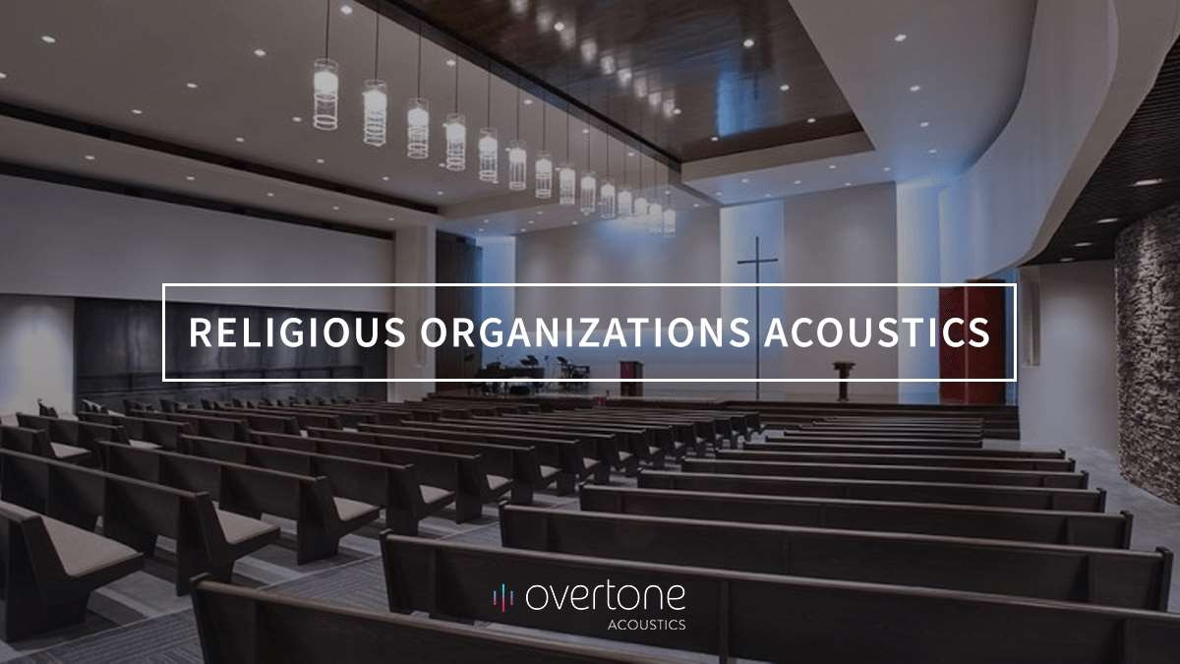
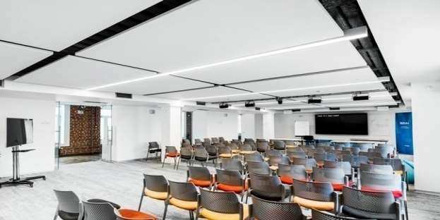
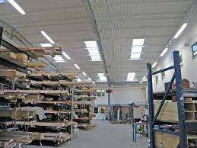
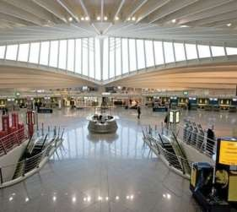
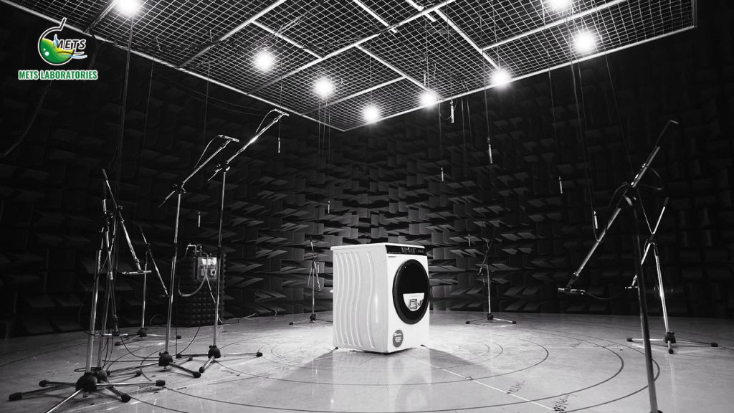
Residential Towers
Convention centre
Open office area
Hotel
Corporate
Core Expertise:
Acoustic Solutions
Stadium
Metros
Theatre
Hospitals
Religious
Schools
Factories
Airports
Technical Labs

Slide 28























Major Projects
Corporates & Experience Centers
Technical Labs, Healthcare, Educational , Industrial, Airports

Slide 29
Major Projects
VM Ware ORR – Bangalore corporate office design and testing
consultancy.
VM Ware Kalyani Vista (KV-2.0) Corporate -Bangalore,
L&T Corporate office Mahape Mumbai.
    Microsoft corporate office – Luxury building – Bangalore.
Google India Opal Corporate office Bangalore.
E-Bay Corporate office Bangalore.
ICICI Prudential Life Insurance Corporate Office Mumbai.
DE Shaw Software Pvt Ltd, Hyderabad.
DNVGL Corporate office Pune.
Standard Chartered Bank Kolkata
HILTI corporate office - Gujarat
Recording Studio for Pristine Design Studio.
Ball Room Acoustics Intercontinental Hotel - Kuwait.
Hilton Olympia Hotel Ball room Acoustics – Kuwait.
Titan Corporate office, Bangalore.
Texas Instruments, Bangalore.
Intel SRR4 Corporate office Bangalore.
ZenQ Corporate office, Hyderabad.
Johnson and Johnson corporate office Bangalore and Hyderabad.
Rozarpay Corporate office Bangalore
Swaram TATA Bangalore.
Corporates

Slide 30
Major Projects
R NS IT A uditorium ( Mu lti purpose H al l 1 400 - seater)
R e v a U n iversity C ol lege A mphitheater ( 1500 S eats & 14 00 A tri um ) B anga lore.
Y a shoda H ospital A u ditori um, H yderabad.
G PR E n g ineering C ollege, S emi na r h a l l A c oustics ( 500 s e ats) , K u rnool, A nd hra P ra desh.
G land P h arma A u ditorium – H y derabad.
G a udi um S c hool A u ditorium – H y dera bad.
H N S c i ence C enter A u ditorium – G a uribidanuru, K a rnataka .
T A bdul W ahid S c hool A uditorium ( 1000 s e a ts) a t A mbur.
K u v empu K a lamandira , C h i kkama galuru, K arnataka.
IT I T h eater – K R P u ram, B a ngalore.
L & T Mu l tipurpose H all.
Vipassana Meditation Centre Pagoda Mumbai
Sachidananda Ganapathi Ashram - Meditation Hall & Auditorium.
Auditoriums
• Kalpataru Real Estate
• Aditya Birla
• In orbit – Rahejas
Residential Segment

Slide 31
Major Projects
Dehradun Airport – Audio and Acoustic Simulation.
Lucknow International Airport – Audio and Acoustic Simulation.
Guwahati International Airport – Adani Group - Acoustics and audio Consultancy
Qualcomm Cafeteria – Acoustics - M Moser Bangalore.
Biocon Cafeteria, Bangalore.
Paypal Cafeteria/Town hall, Bangalore.
Cafetaria / Town Hall – ABB
JW Marriot – Juhu Mumbai – WIP
Inter Continental - Kuwait. – Completed
Hyatt Bangalore – WIP
Grand Oberoi – WIP
ITC Coorg – Completed – Indirect.
JW Marriot – Sahar Mumbai – Completed.
Western Lake – Pawai Mumbai
Marriott Hotel Vashi Mumbai.
HICC – WIP
West Inn Powai , Mumbai
Marie Gold Hyderabad
Airports
Town Hall
Hospitality

Slide 32
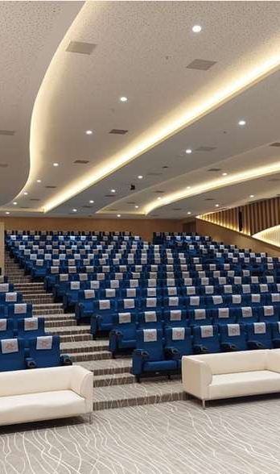
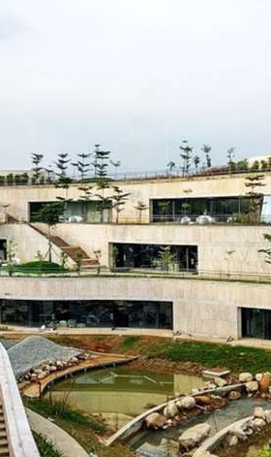
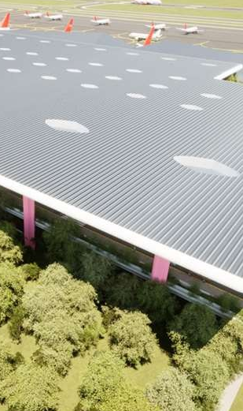
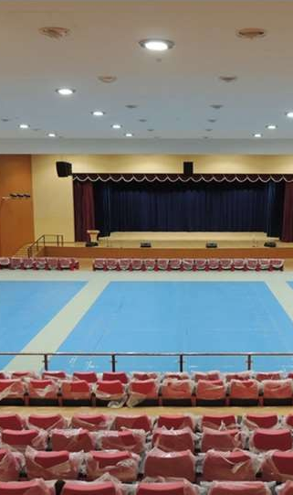
Our Key Projects
Yashoda Hospital Auditorium
(450 Seats - Hyderabad
TITAN Company Acoustics Design & Consultancy
(2.0 L Sq.Ft. – Bangalore)
Guwahati International Airport
Assam India (6.0L Sft. - Guwahati)
RNS Institute of Technology Auditorium
(Indoor Sports Hall - 1400 Seater Auditorium)

Slide 33
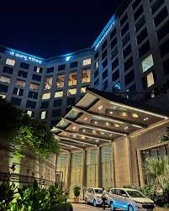
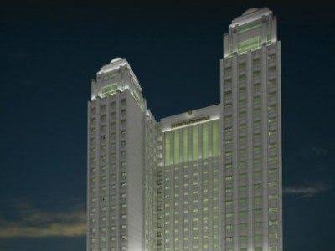
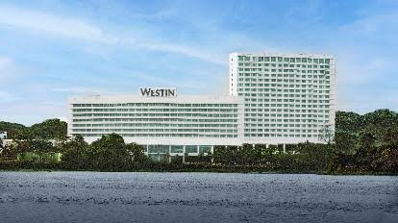
JW Marriot – Sahar
Our Key Projects
Intercontinental Hotel Kuwait
West In Mumbai
Location : Mumbai
Scope of Works : Acoustics Consultancy Services
Location : Kuwait
Scope of Works : Acoustics Consultancy Services
Location : Mumbai
Scope of Works : Acoustics Consultancy Services

Slide 34
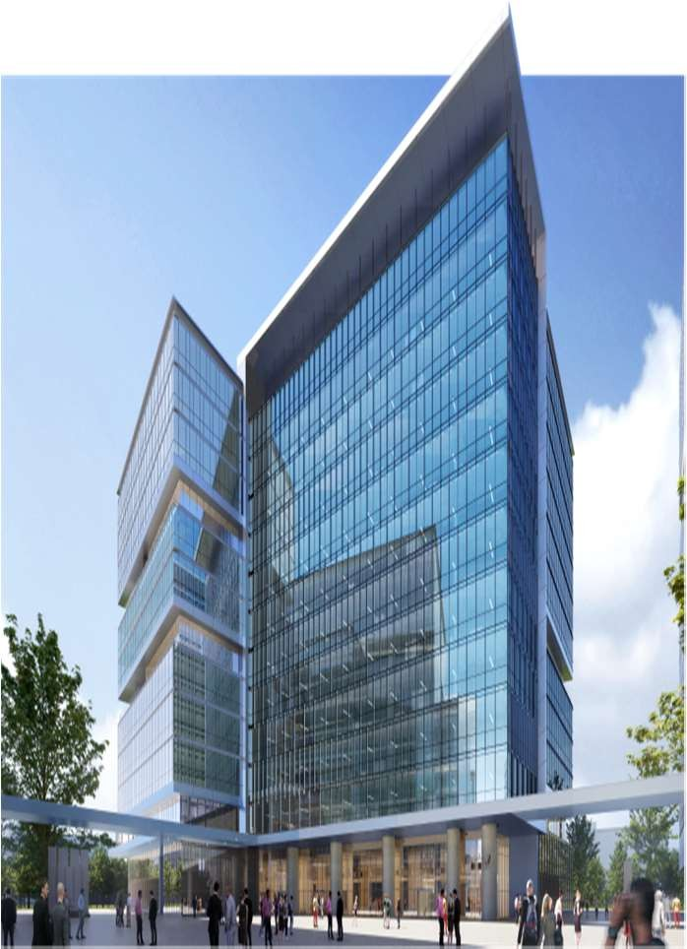
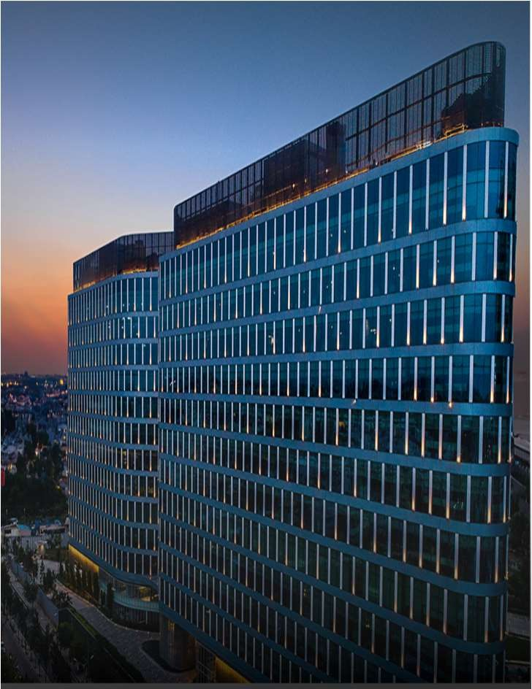

Way fair - Bangalore
Google Opel - Bangalore
Our Key Projects
Hilti -Vadodara
Total Area : 3.0L Sft.
Location : Bangalore
Scope of Works : Acoustics Consultancy Services
Total Area : 4.0 L Sft.
Location : Bangalore
Scope of Works : Acoustics Consultancy Services
Total Area : 1.5 L Sft
Location : Vadodara
Scope of Works : Acoustics Consultancy Services

Slide 35



CONTACT US
Phone
+91 93916 51916
+91 98450 64815
Mail
padmanabha@awareacoustics.in
srikanth@awareacoustics.in
| AWARE Acoustics |

Slide 36

THANK YOU
| AWARE Acoustics |

